Slide 1
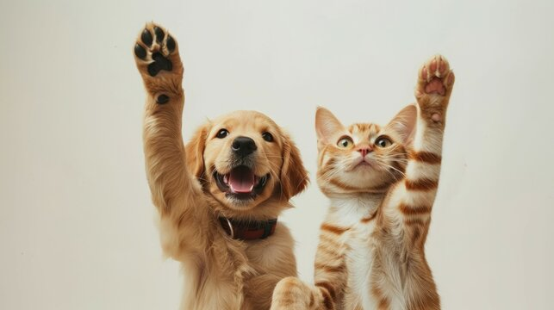

Paws for Hope

Slide 2
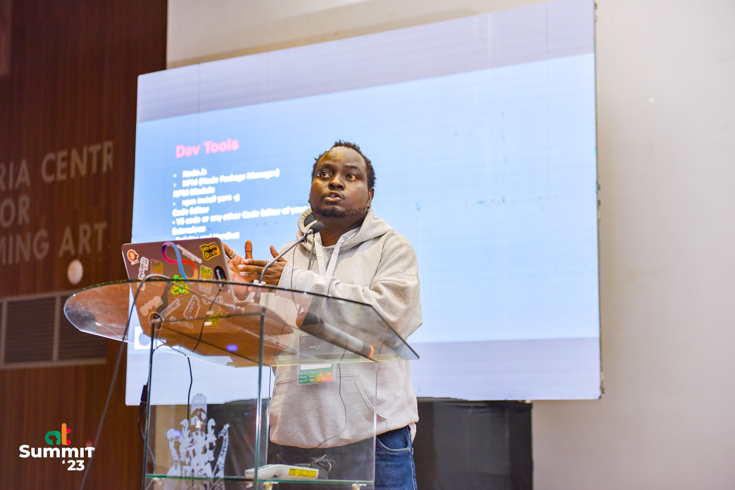
Jordan Muthemba
Smart Contract Developer

Slide 3
Problem
Frequent Loss of Pets: Every day, numerous pets are lost due to escapes, accidents, or natural disasters, creating distress for both owners and animals.
Emotional and Practical Challenges: Lost pets cause significant emotional distress for owners while leaving animals vulnerable and at risk.
Inadequate Resources: Many pet owners lack access to sufficient resources or tools to report and search for their missing pets effectively.
Need for a Better Solution: The absence of an organized and efficient system highlights the need for a comprehensive platform to assist in locating lost pets.

Slide 4
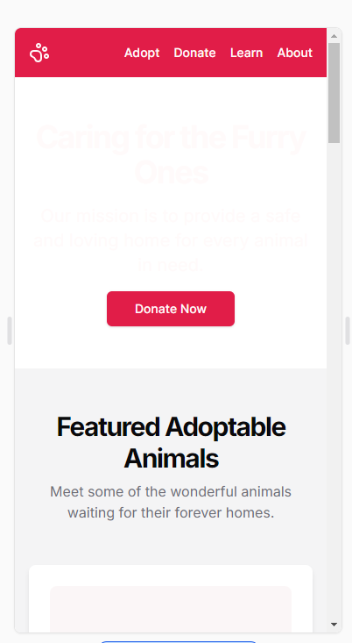
Solution
A blockchain-based decentralized platform for reporting and locating lost pets.
Notes:
Key Features:
Owners can report lost pets, including details such as photos, last known location, and distinguishing features.
Community members can view reports and assist in finding lost pets.
Smart Contracts for Rewards:
Utilize smart contracts to manage and automate reward distribution for those who help locate lost pets.
Ensure transparency and trust in the reward process.
Community Engagement:
Foster collaboration between pet owners and community members to create a supportive network for finding lost pets.
Secure and Transparent System:
Use blockchain technology to maintain a secure and immutable record of reports and transactions.
Build trust by ensuring all activities are transparent and tamper-proof.
Incentives:
Reward community members who successfully locate and return lost pets with tokens or other incentives.
Geo-Tagging:
Include geo-location features to assist in narrowing search efforts to specific areas.
Mobile-Friendly Design:
Create a user-friendly interface optimized for mobile and desktop platforms for ease of use.
Social Sharing:
Integrate social media sharing options to amplify search efforts for lost pets.
Decentralized Governance:
Allow the community to propose and vote on platform improvements through decentralized governance mechanisms.

Slide 5

Market
Project Market
Pet Owners
Animal Welfare Organizations
Local Community
Veterinarians and Pet Stores
Web3 Technology Providers
Government Institutions

Slide 6
Technical proposal
Technical Proposal
Decentralized Architecture
Smart Contracts
User-Friendly Interface
Verification System
Real-Time Notifications
Additional Features

Slide 7
Technologies used
01
02
Frontend
Smart Contracts
NEXT.JS Shadcn
Solidity language
Deployed on Cypherium
Hardhat testing

Slide 8
Contract diagram

Slide 9
Business model
Smart contracts:
findPet.sol
donate.sol
token.sol
redeemtoken.sol

Slide 10
Future plans

Slide 11
Thank you so much!

